Slide 1


Laboratorio di Applicazioni Web e Cloud
Lezione 2 – Bootstrap
Filippo Gaudenzi
https://github.com/anonymez/CloudWebApplicationLab

Slide 2

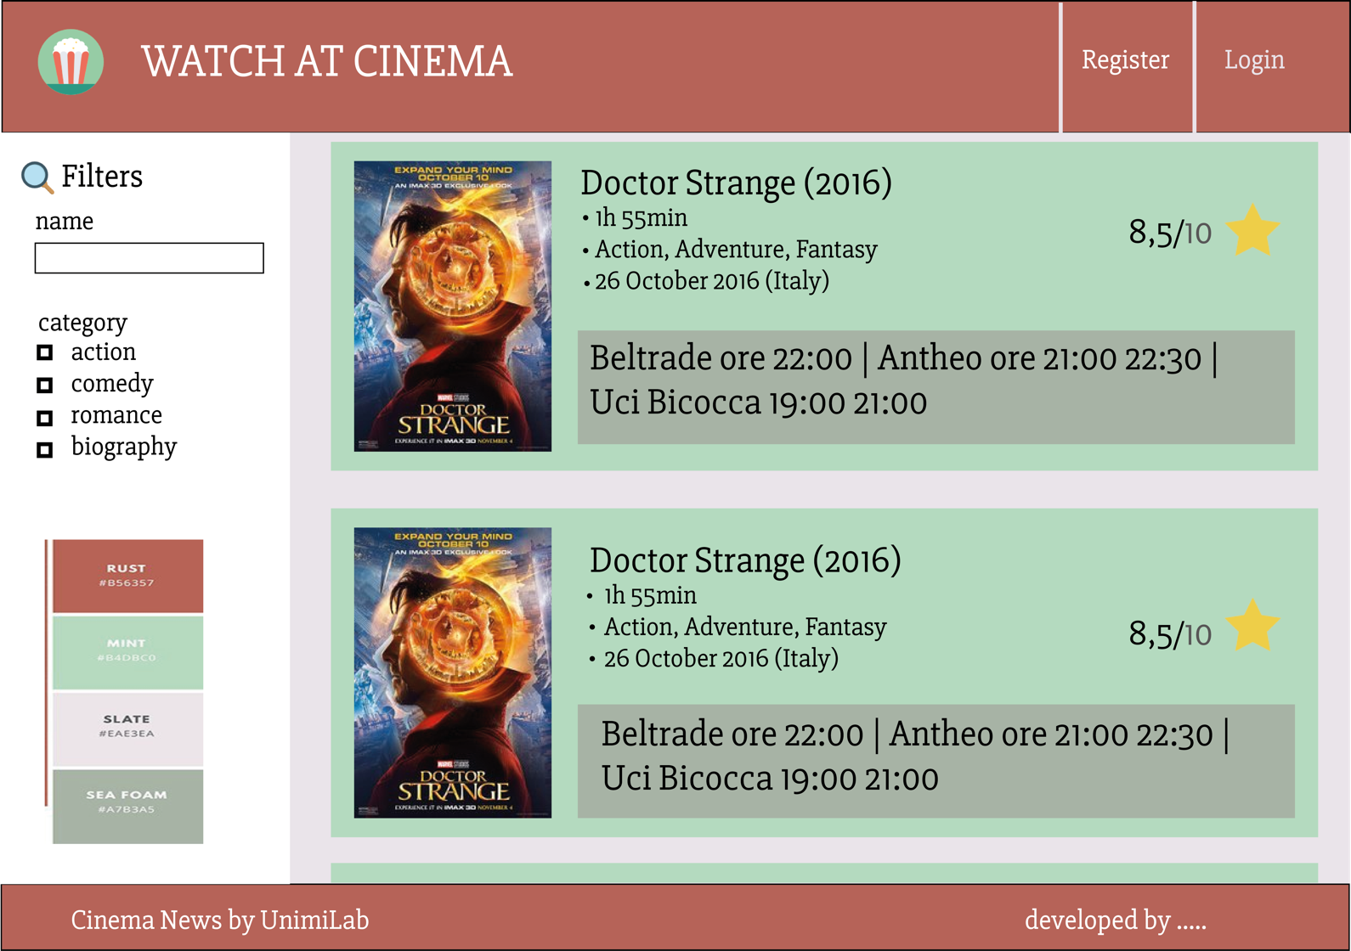
Introduzione
Nella lezione 1 abbiamo visto come creare utilizzando CSS e HTML questa pagina web
Filippo Gaudenzi - AWC

Slide 3
Web Framework
Un web framework ci aiuta nello svilluppo di applicazione web (server-side o front-size) fornendoci una serie di astrazioni sempre pero’ basate su codice esistente.
Front End | Server Side
Bootstrap, Material, AngularJS, React, Vue .. | Java – (Spring, Jersey..) PHP – (Lavarel, Symphony) Python – (Django, Flask, Tornado) Javascript – (NodeJS)
Filippo Gaudenzi - AWC

Slide 4
Bootstrap (getbootstrap.com)
Bootstrap is an HTML, CSS, and JS framework for developing responsive, mobile first projects on the web.
Preprocessors
Bootstrap ships with vanilla CSS, but its source code utilizes the two most popular CSS preprocessors, Less and Sass. Quickly get started with precompiled CSS or build on the source.
One framework, every device.
Bootstrap easily and efficiently scales your websites and applications with a single code base, from phones to tablets to desktops with CSS media queries.
Full of features
With Bootstrap, you get extensive and beautiful documentation for common HTML elements, dozens of custom HTML and CSS components, and awesome jQuery plugins.
Filippo Gaudenzi - AWC

Slide 5
Bootstrap (getbootstrap.com)
https://getbootstrap.com/docs/3.3/components/
https://getbootstrap.com/docs/3.3/css/
Filippo Gaudenzi - AWC

Slide 6
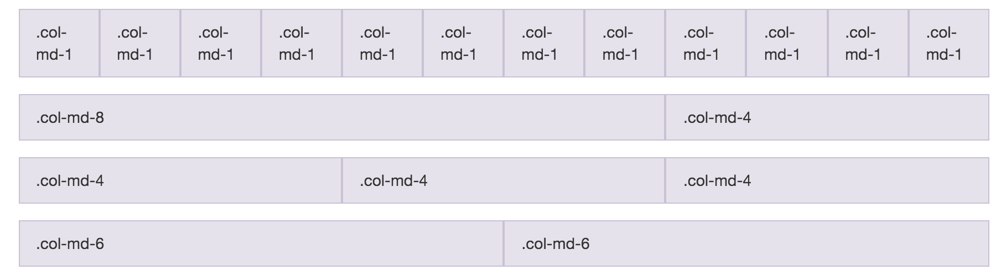
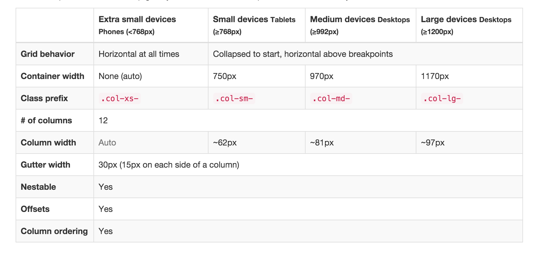
GRID SYSTEM
mediaquery
Filippo Gaudenzi - AWC

Slide 7
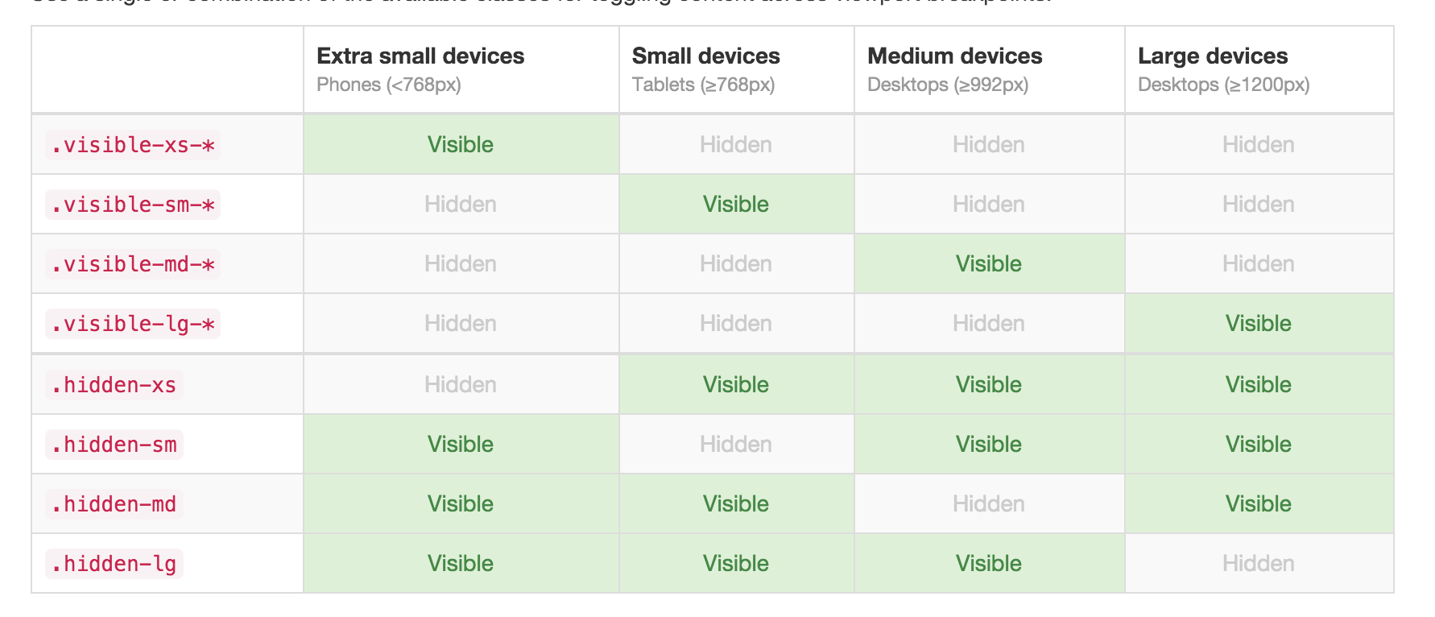
mediaquery
Filippo Gaudenzi - AWC

Slide 8
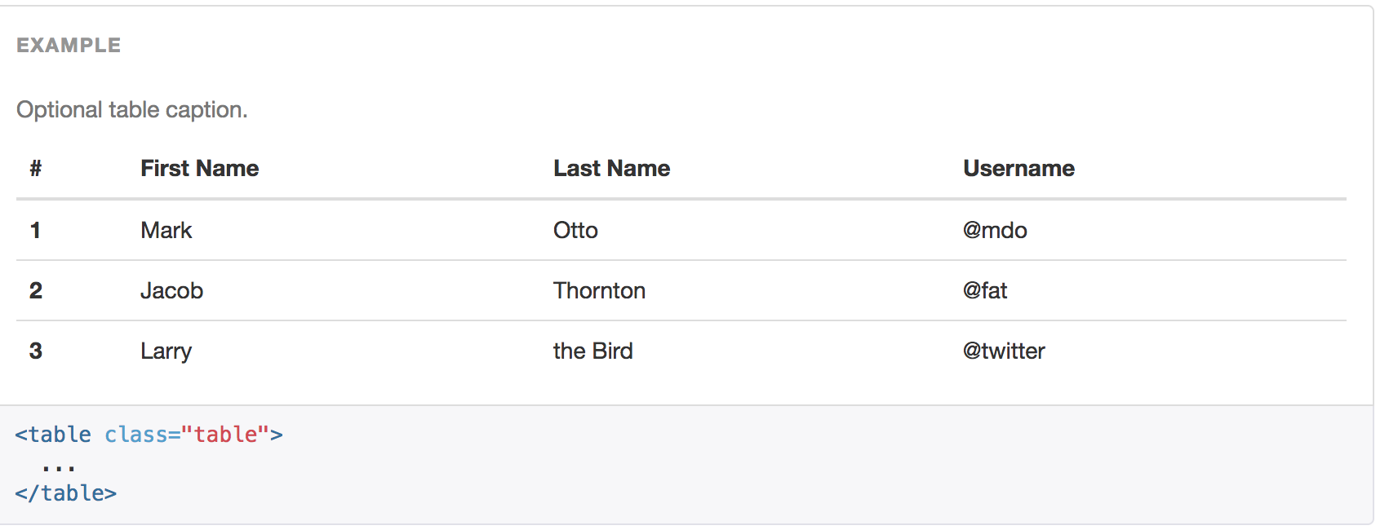
Example (table)
Filippo Gaudenzi - AWC

Slide 9
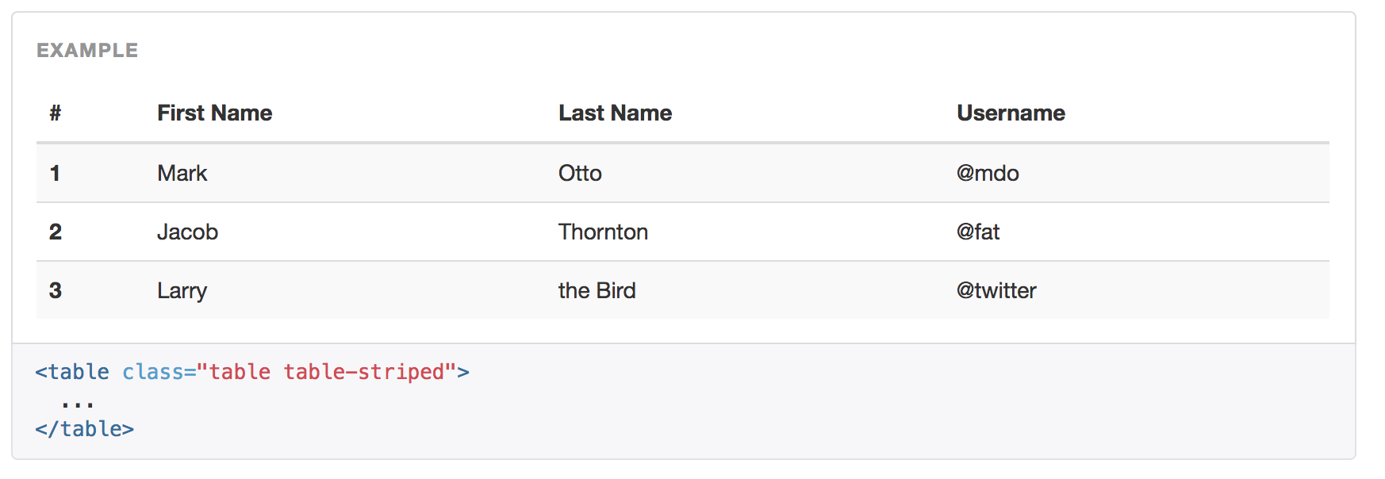
Example (table)
Filippo Gaudenzi - AWC

Slide 10
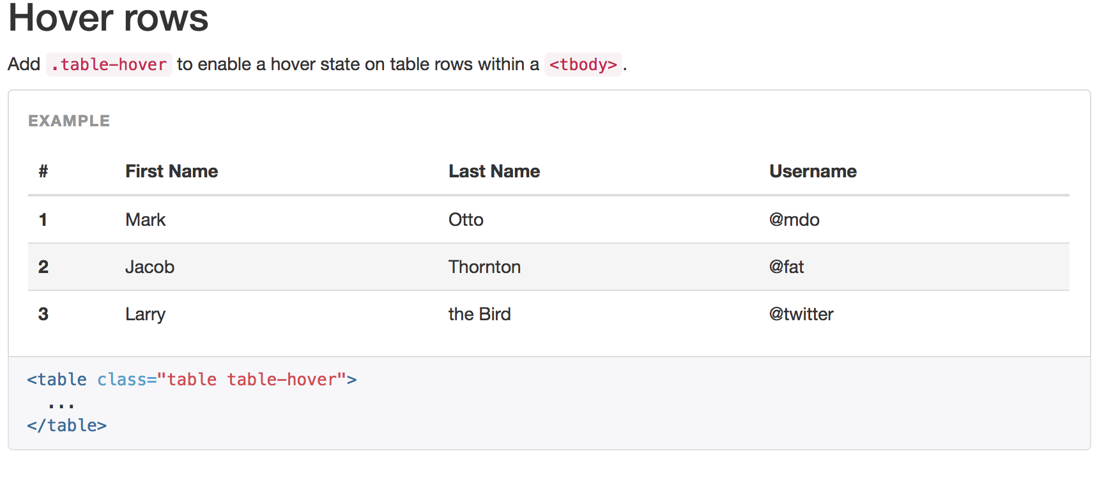
Example (table)
Filippo Gaudenzi - AWC

Slide 11
(table)
Filippo Gaudenzi - AWC

Slide 12
Cinema Project
Filippo Gaudenzi - AWC

Slide 13
Cinema Project
NAVABAR
CONTAINER
FOOTER
Filippo Gaudenzi - AWC

Slide 14
Cinema Project
NAVABAR
CONTAINER
FOOTER
Filippo Gaudenzi - AWC

Slide 15
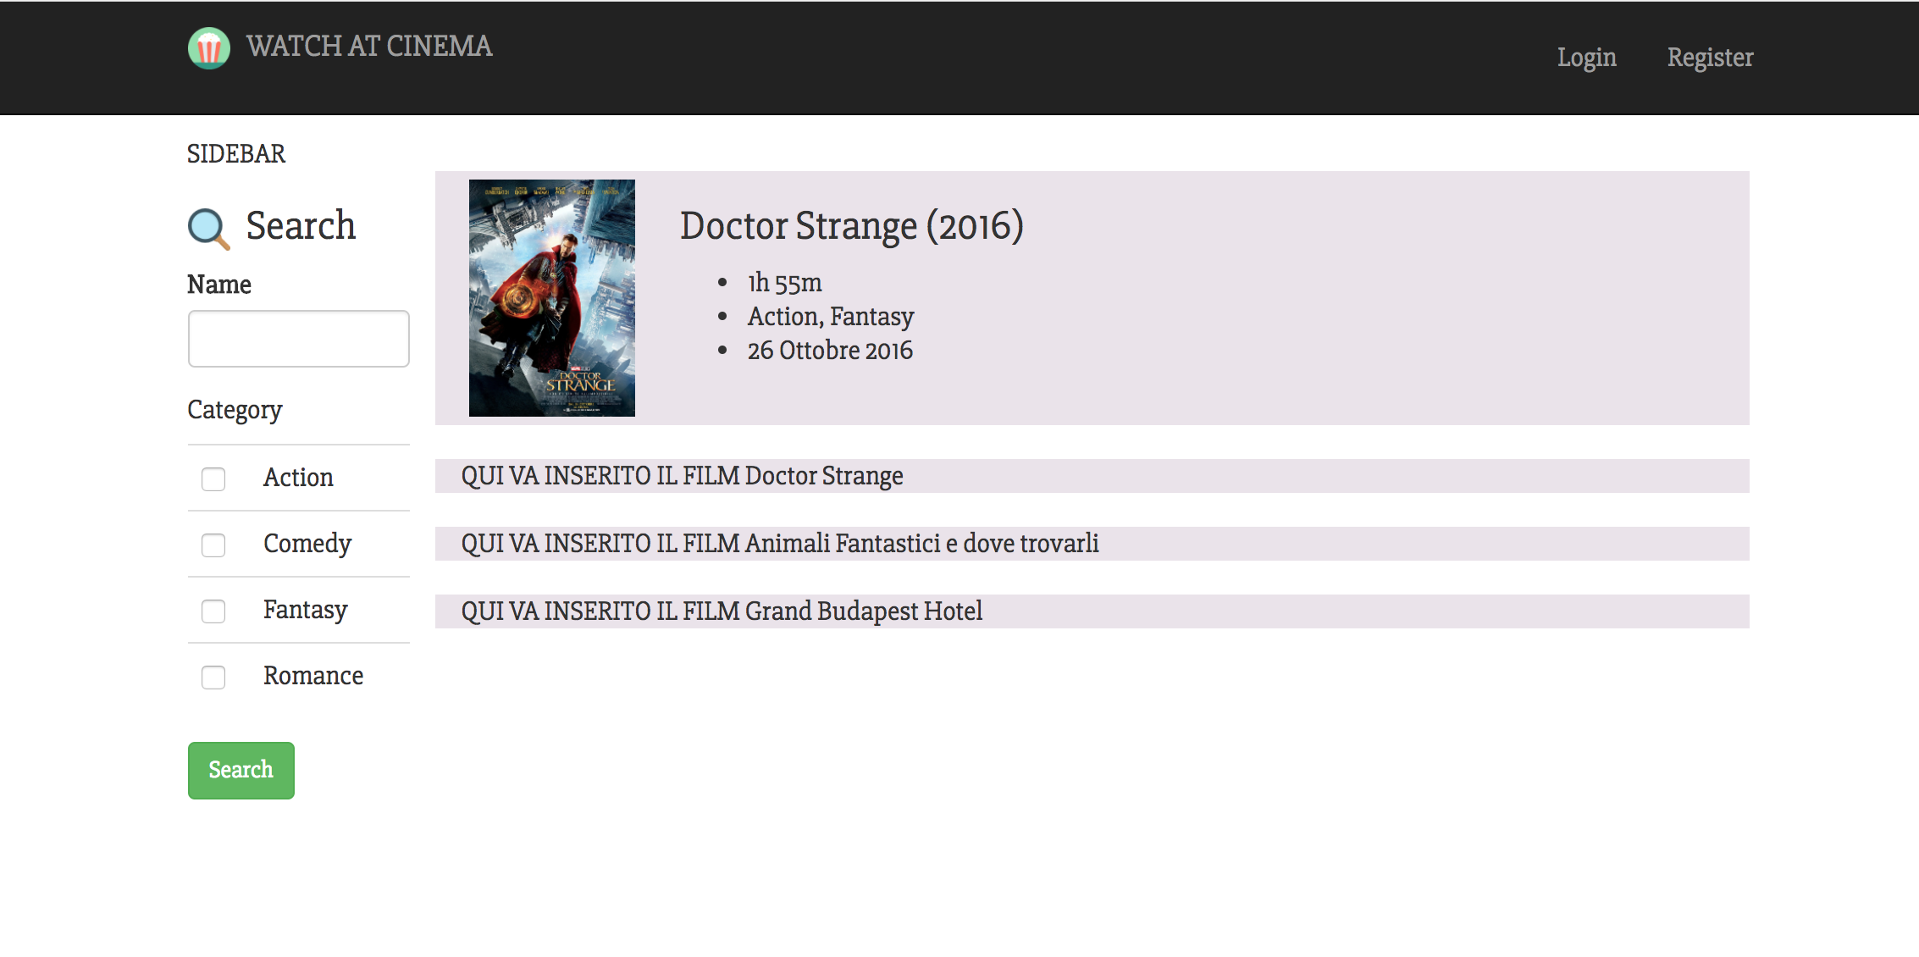
Cinema Project
Filippo Gaudenzi - AWC

Slide 16
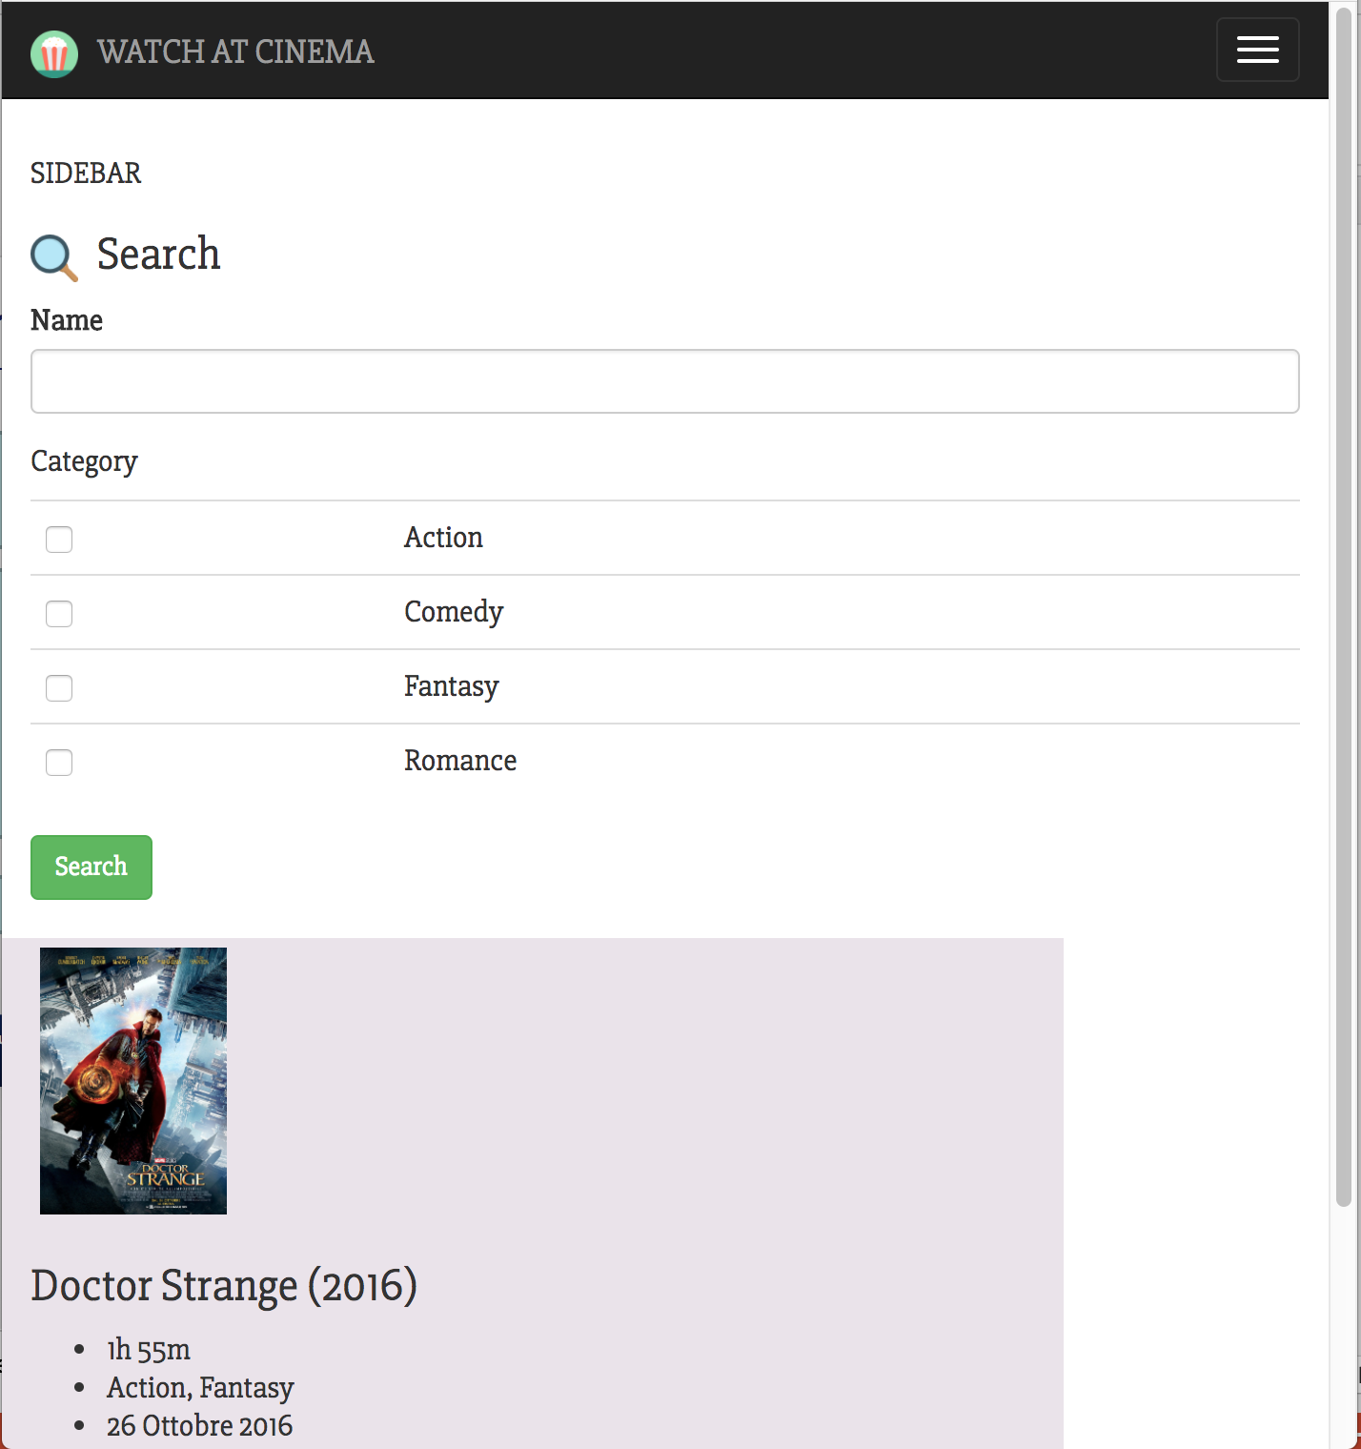
Cinema Project
Filippo Gaudenzi - AWC

Slide 17
Cinema Project
row
col
Filippo Gaudenzi - AWC

Slide 18
Cinema Project
row
col
col-md-3
col-md-9
Filippo Gaudenzi - AWC

Slide 19
Cinema Project
row
col
col-md-2
col-md-10
Filippo Gaudenzi - AWC

Slide 20
Cinema Project
row
col
col-md-2
col-md-10
span
form
form-group
label/input
table
checkpoint
Filippo Gaudenzi - AWC

Slide 21
Cinema Project
row
col
col-md-2
col-md-10
span
form
form-group
label/input
<div class="form-group">
<label for="name_movie">Name</label>
<input type="text" name="name_movie" class="form-control">
</div>
table
checkpoint
Filippo Gaudenzi - AWC

Slide 22
Cinema Project
row
col
col-md-2
col-md-10
span
form
form-group
label/input
<table class="table">
<tbody>
…
</tbody>
</table>
table
checkpoint
Filippo Gaudenzi - AWC

Slide 23
Cinema Project
row
col
JUST DO IT.
col-md-2
col-md-10
span
form
form-group
label/input
table
checkpoint
Filippo Gaudenzi - AWC

Slide 24

Il repository contiene l’intera soluzione all’esercizio utilizzando il file home.html e il relativo foglio di stile styleD-modified.css

